Slide 1
JavaScript Objects & Variable Rules
BDPA SITES Indy
04/11/20

Slide 2





Even More Variables Rules

Slide 3
Global vs Local Variables
var count = 0;
var sum = 10;
function method (occurrences) {
if sum < 20 {
var temp = 7;
var count = 2;
occurrences ++;
}
}
method (count);
LOCAL variables are declared inside of a function.
They can only be accessed in that function
GLOBAL variables are declared outside of a function.
They can accessed anywhere

Slide 4
Variable Scope
(Local) Function Scope
Block Scope
It means they are only available inside the function they’re created in
if not created inside a function, they are ‘globally scoped’
When called outside of a function a error occurs
A block scope is the area within if, switch and/or for and while loops.
if not created inside a block {curly brackets}, they are ‘globally scoped’
When called outside of the block a error occurs

Slide 5

Keywords: var, let and const
var: limited to the “function” within which it is defined. If it is defined outside any function, the scope of the variable is global.
let: limited to the “block” defined by curly braces i.e. {} .
const: limited to the “block” defined by curly braces i.e. {} and cannot be reassigned

Slide 6
Keywords: var, let and const Examples
var sum = 0;
function test (isPositive) {
var sum = 1;
console.log(sum); // returns 1
const MAX = 1000;
MAX = 2000; //Error: constant cannot
}
console.log(sum); // returns 0
var x = 10; // Here x is 10 { var x = 2; // Here x is 2 } // Here x is 2
var y = 10; // Here y is 10 { let y = 2; // Here y is 2 } // Here y is 10

Slide 7
Strict Mode
Non-Strict
Strict
var x = 0;
function foo() {
var x = y = 1; // Declares x locally; declares y globally.
}
foo();
console.log(x, y); // 0 1
// x is the global one as expected;
// y is leaked outside of the function, though!
var x = 0;
function foo() {
var x = y = 1; // Throws a ReferenceError
}
foo();
console.log(x, y);

Slide 8

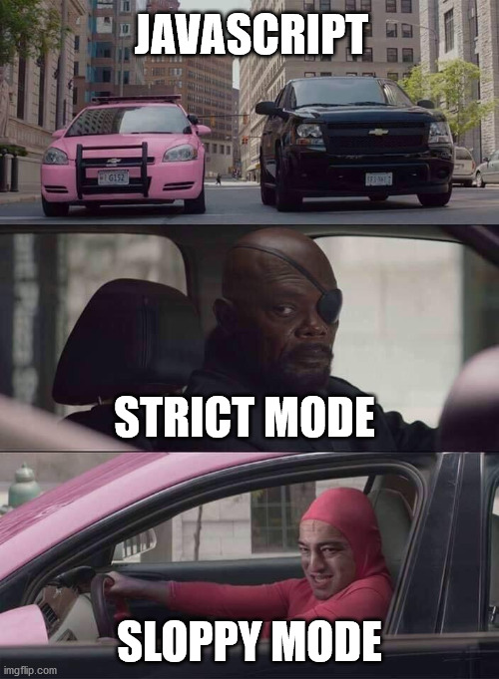
Strict Mode
Eliminates some JavaScript silent errors by changing them to throw errors.
Non-strict mode is often called “Sloppy code”
Strict mode applies to entire scripts or to individual functions.
Uses keywords 'use strict’;
Not all browsers support strict mode

Slide 9

Any questions on variables?

Slide 10

Object Oriented JavaScript

Slide 11
Data Types
Primitive (single value)
Reference(multi value)
Boolean
Number
Symbol
Null
Undefined
Array
Function
Objects

Slide 12
What is an object?
An unordered collection of related data, of primitive or reference types.
Variables that are assigned a non-primitive value are given a reference to that value. That reference points to the object’s location in memory. The variables don’t actually contain the value.
Nearly everything is an object in JavaScript. If you understand objects, you understand JavaScript.

Slide 13
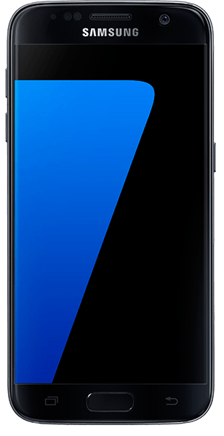
What is an object?
Properties are the values associated with a JavaScript object in the form of “key: value” pairs.
Methods are properties containing function definitions
Object | Property | Method
 | phone.model = “S7”; | call(number);
 | phone.color = “black”; | text(number, message);
 | phone.number = “317-XXXX”; | unlock(code);
 | phone.storageGB = 64; | voicemail();

Slide 14
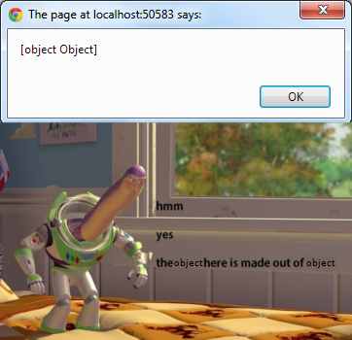
Defining Objects & Accessing Properties
//Defining Objects
var objectName = {
propertyName1: value,
propertyName2: value
};
//Accessing properties
objectName.propertyName
OR
objectName["propertyName"]

Slide 15
Defining & Accessing Methods
var person = { firstName : "John", lastName : "Doe", fullName : function() { return this.firstName + " " + this.lastName; } };
person.id = 5566;
name = person.fullName();
//Defining object
var objectName = { propertyName1 : value, methodName1 : function() { return this.propertyName1; } };
//Add new properties or methods
objectName.propertyName2 = value;
objectName.methodName2 = function() { return value; }
//Accessing Methods
objectName.methodName2();

Slide 16
Object Constructors
function Phone(model, number, color, storageGB) {
this.model = model;
this.number = number;
this.color = color;
this.storageGB = storageGB;
}
Phone.prototype.code = 1234;
var myPhone = new Phone( );
console.log(myPhone.model);
Good for creating multiple of the same object
You cannot add a new property to an existing object constructor without the property keyword prototype

Slide 17
Class Constructors
class name {
constructor(propertyName)
{
this.propertyName = value;
}
methodName() {
//write code here
}
}
let object = new name(parameter);
Cleanest way to create objects
Best for objects that you will create often
Classes are available in nearly all object oriented

Slide 18

Extending Classes
class Car { constructor(brand) { this.carName = brand; } present() { return 'I have a ' + this.carName; } }
class Model extends Car { constructor(brand, mod) { super(brand); this.model = mod; } display() { return this.present() + ', it is a ' + this.model; } } mycar = new Model(“BMW", “Banana");
console.log(mycar.display());

Slide 19
Static Methods
class Car { constructor(brand) { this.carName = brand; }
static hello() { return "Hello!!"; } } mycar = new Car(“BMW");
//Call 'hello()' on the class Car: Car.hello(); //and NOT on the 'mycar' object: //mycar.hello(); would raise an error.

Slide 20
Object Accessors
Getters
Setters
var person = { firstName : "John", lastName : "Doe", language : "en", get fullName() { return this.firstName + " " + this.lastName; } };
let name = person.fullName;
var person = { firstName: "John", lastName : "Doe", language : "", set lang(lang) { this.language = lang; } };
person.lang = "en";

Slide 21
Predefined Wrapper Class Objects
Array
String
Boolean
Number
Date

Slide 22
Number
Methods | Properties
isFinite() | MIN_SAFE_INTEGER
isInteger() | MAX_VALUE
isNaN() | MIN_SAFE_INTEGER
isSafeInteger() | MIN_VALUE
toExponential() | NEGATIVE_INFINITY
toFixed() | NaN
toPrecision() | POSITIVE_INFINITY
toString() | prototype
The JavaScript Number object acts as a wrapper for primitive numeric values
All integers and floats are both number objects
Special keywords:
Infinity
-Infinity

Slide 23
Date
Setter Methods | Getter Methods
setDate() | getDate()
setFullYear() | getFullYear()
setHours() | getHours()
setMilliseconds() | getMilliseconds()
setMinutes() | getMinutes()
setMonth() | getMonth()
setSeconds() | getSeconds()
setTime() | getTime()
 | getDay()
 | Date.Now()
new Date()
new Date(year, month, day, hours, minutes, seconds, milliseconds)
new Date(milliseconds)
new Date(date string)

Slide 24
Any questions on objects?

Slide 25
Next Class Review Session
Next class 04/25/20 is a review session
An open dialog with any question
The take home exam is due 05/01/20
It will be a cumulative quiz on all material thus far
One-on-one office hours available as well

